Slide 1

How AI facilitates mobility in Moscow
Dmitry Denisov

Slide 2
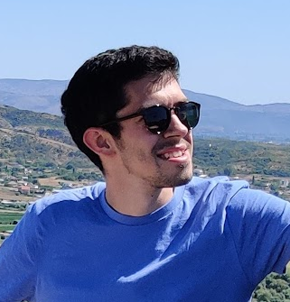
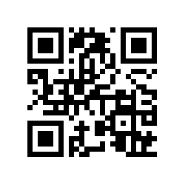
Myself
Work as Data Scientist in Careem (Fraud department)
Before: Data Scientist in Deloitte
Interested in Education sphere:
- Conducted a Deep Learning course https://www.coursera.org/learn/intro-to-deep-learning
- Course for Open Data Science community: https://bit.ly/3csuc0g
Data Science course in Saudi Arabia
Background: Data Science/Math, Bachelor’s in Applied Math and Masters in Data Science

Slide 3



Content
Tech!!!
FacePay in metro
How FacePay works inside
Find criminals in metro
Retail: FacePay
Bank: ATM confirmation by face
Transport: different use cases
Transport: self-driving taxi

Slide 4
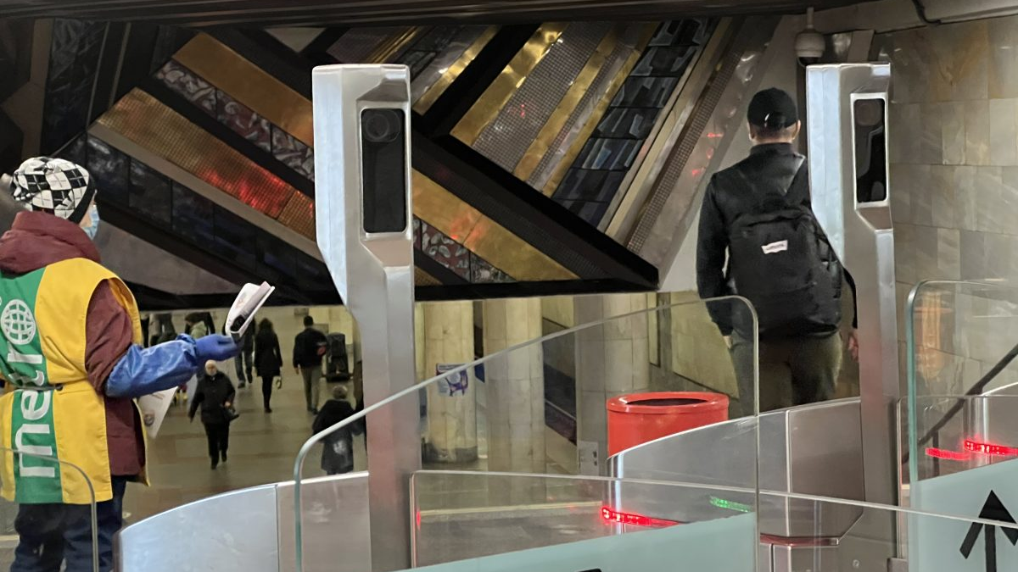
Moscow Metro: Face Pay
Starting from 15th Oct 2021

Slide 5
Main difference with Apple FaceId
Compare input image not with one existining obejct, but with enormous number of objects

Slide 6
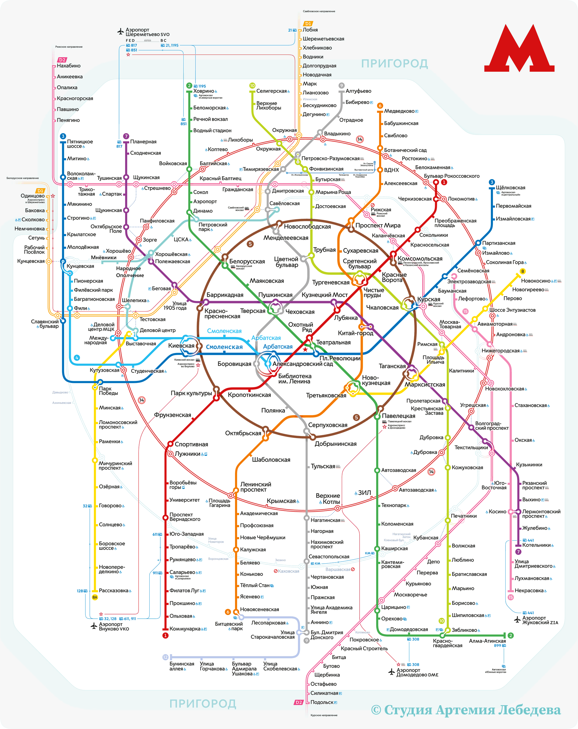
Scale:
241 stations

Slide 7
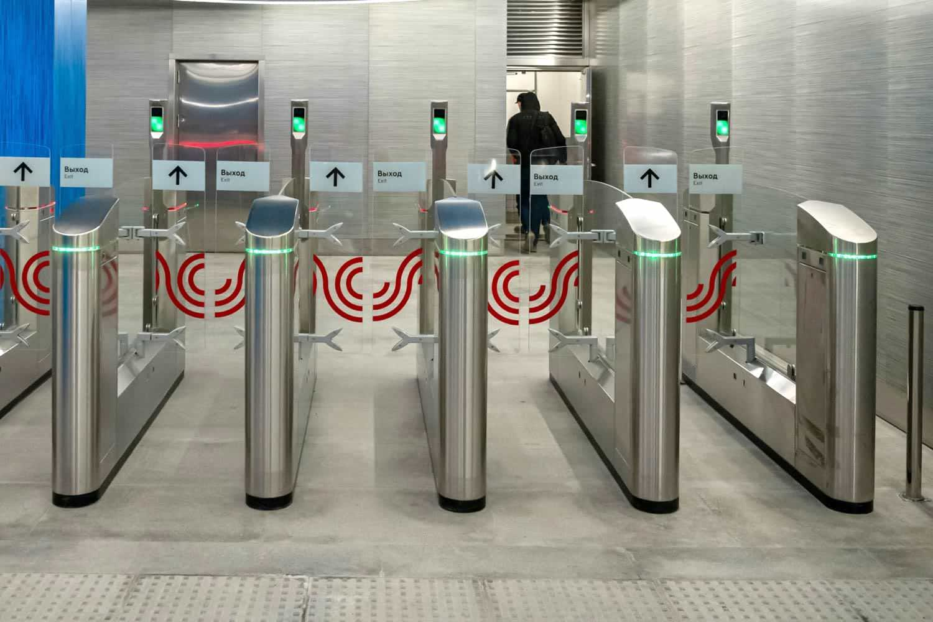

Slide 8
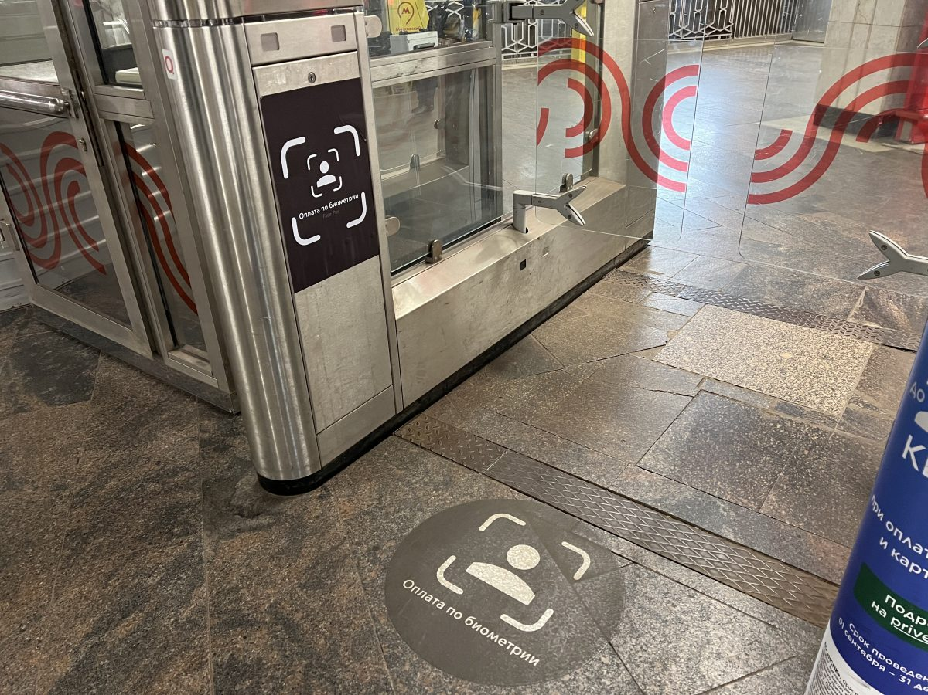

Slide 9
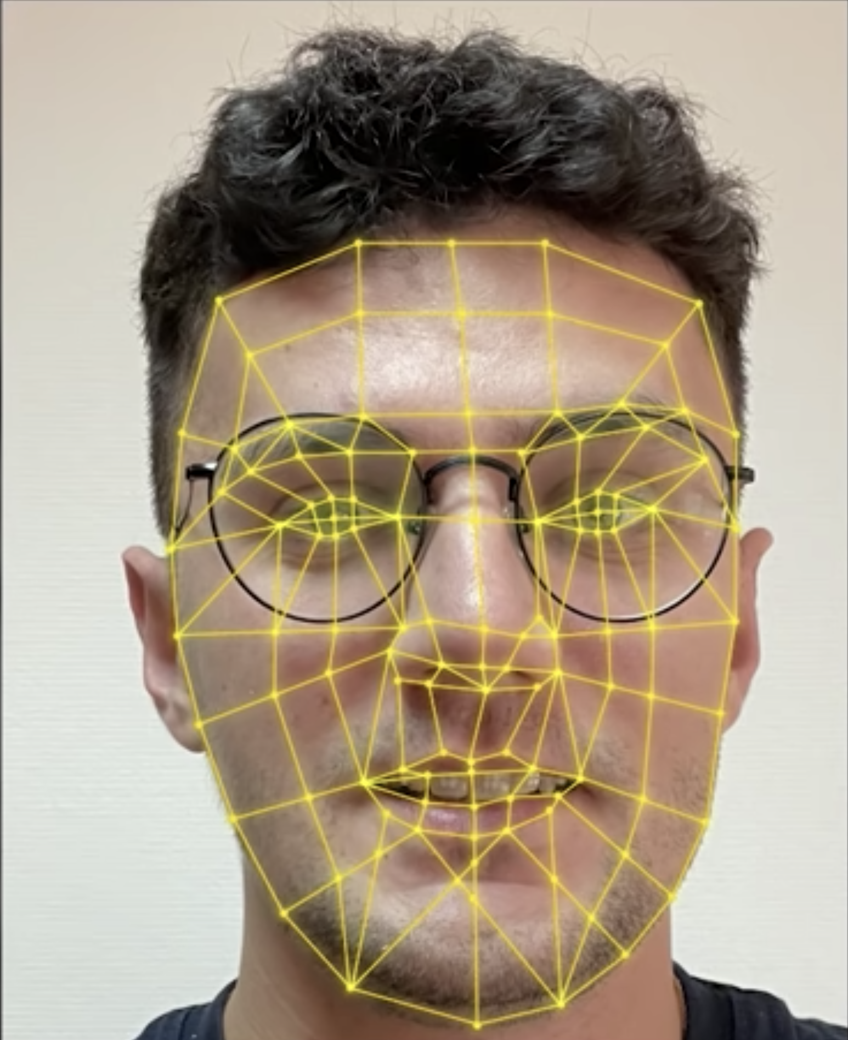
How it works (user experience)
Add your photo in Metro Application
Come to the turnstile with camera and pass

Slide 10
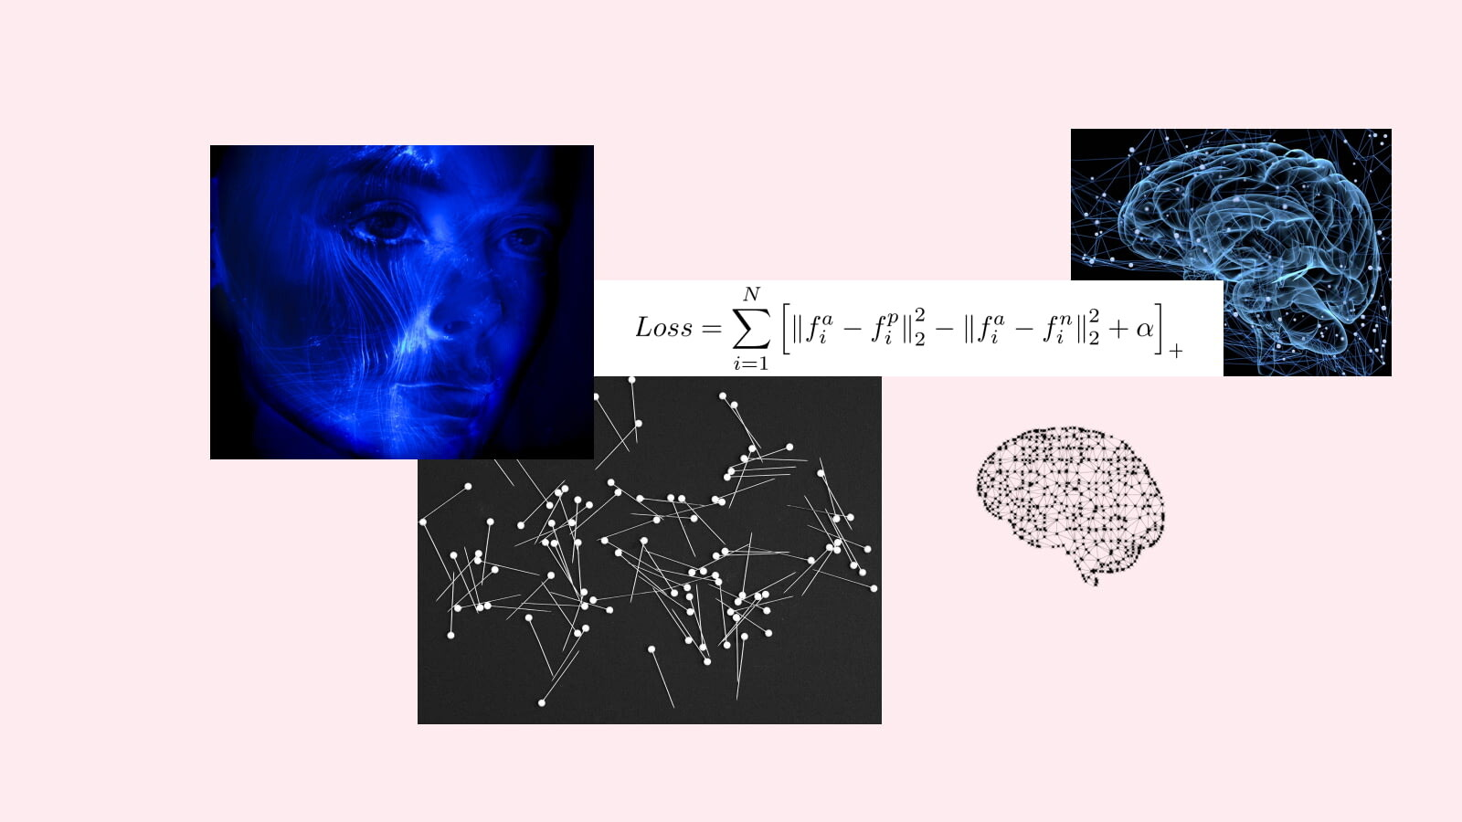
How it works (inside)

Slide 11
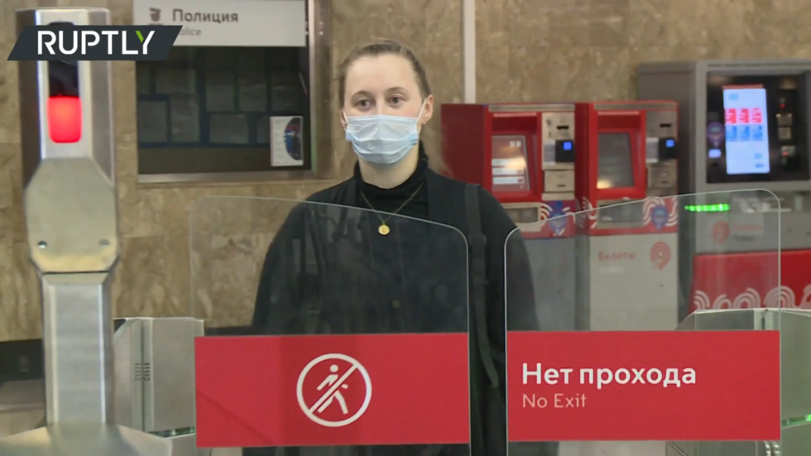
How it works (online)
Receive input photo of a customer
Face Detection: Find customer on the photo
Face Descrition: On found frame run model, which was offline trained using triplet loss
Find in Data Base closest Face Desctiptor

Slide 12
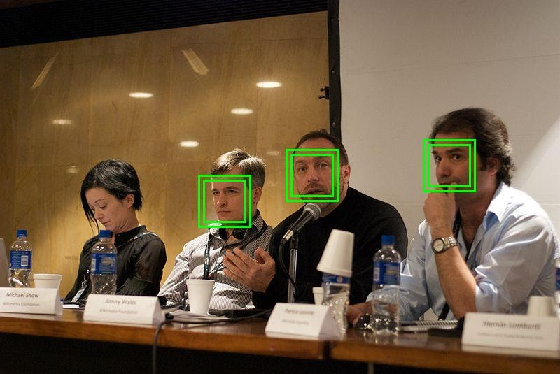
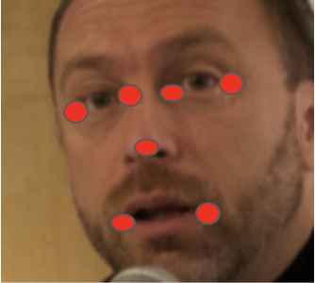
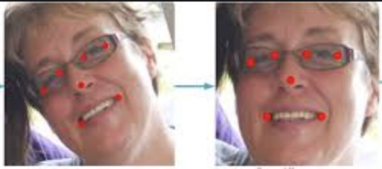
Face Detection
Step 1
Step 2
Step 3

Slide 13
Face Descrition
Train Neural Network (offline)
Input – photo of a person
Output – vector of numbers (called Face Descriptor)
Face Descriptor property 1: for different people distance between corresponding vectors should be large
Face Descriptor property 2: approximately the same vector for images of the same face changed depending on hairstyle, makeup, headdress, angle, light and other factors

Slide 14
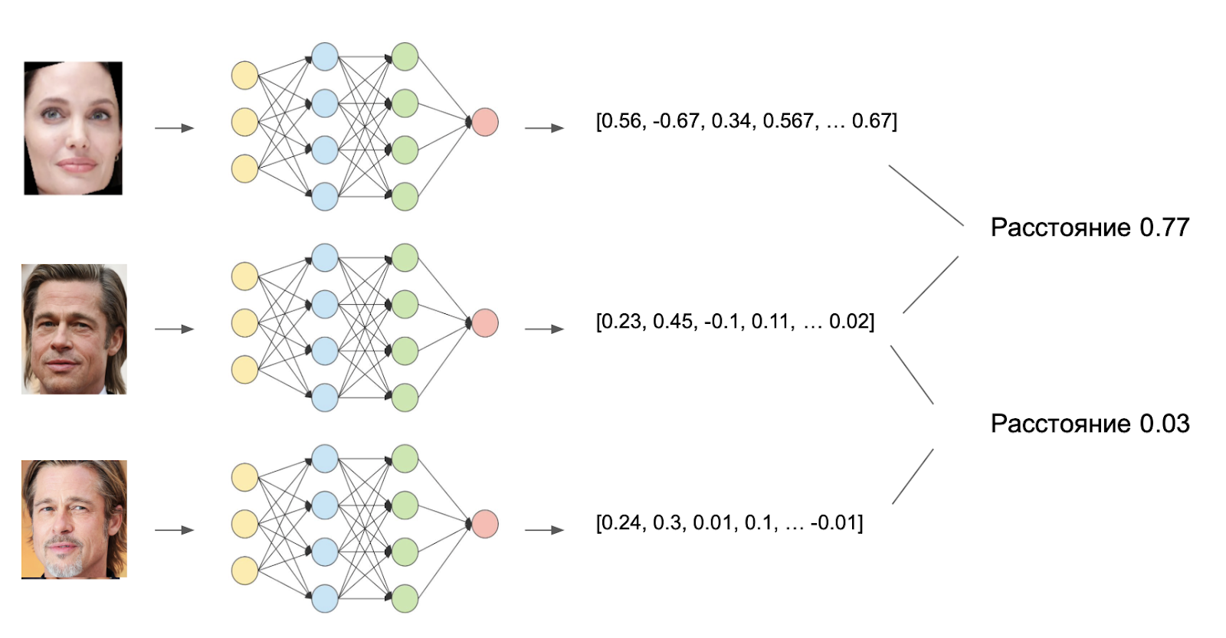
Or visually our idea is:
distance 0.77
distance 0.03

Slide 15

Idea of training loss:
We want: distance(A, P) <= distance(A, N)
To avoid 0 solution: distance(A, P) + c <= distance(A, N), c - constant

Slide 16
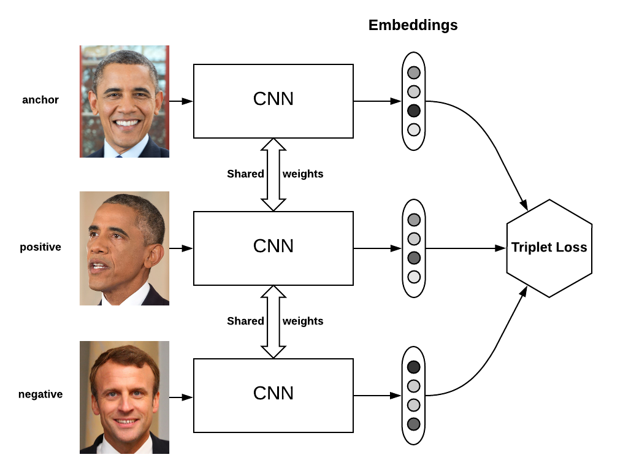


Triplet Loss

Slide 17
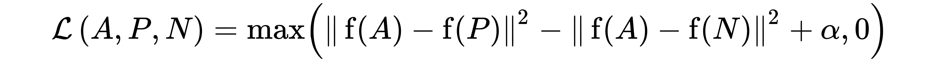
How to train such model?
Triplet loss:
Here:
- A = some photo from training dataset
- P = different photo of person A, but taken in different condition (angle, brightness, etc.). Or augmented
- N = photo of another person
f = Neural Network
Source: https://www.youtube.com/watch?v=Hl8fjhNwOtg

Slide 18

Training schema

Slide 19
How to make training set?
10k pictures
1k persons
Generate set of triplets: (A, P, N)
This is how we get training dataset!

Slide 20
How it works (offline)
Train Face Detection model
Train Face Description (using triplet loss)
Create a Databse, each user will have unique vector, i.e Face Descrition
For each new customer we calculte his Face Descrition and add it to the DataBase

Slide 21
Some stats
4 months testing period for 85k employees (April – August 2021)
1 month testing for small subset of real customers (August 2021)
Available for everyone since 15th Oct 2021
Each entrance has one turnstile supports FacePay
Accuracy is high (apparently > 95%, but unfortunately exact number is not provided)
With probability >70% will be able to identify person in mask

Slide 22
Problems
Around 1-2 seconds response => problems in rush hour
Makeup
Different seasons (summer/winter)
Fraud: someone can remove his head in the correct moment such that you will pay

Slide 23
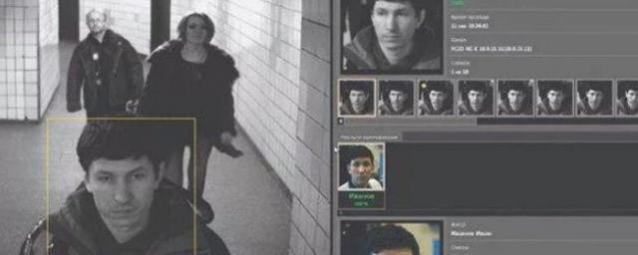
Find criminals + lost people in metro (Project Sphere)
Working starting from Sept 2020
For 2021: 1519 criminals arrested
For 2021: 221 lost people were found

Slide 24
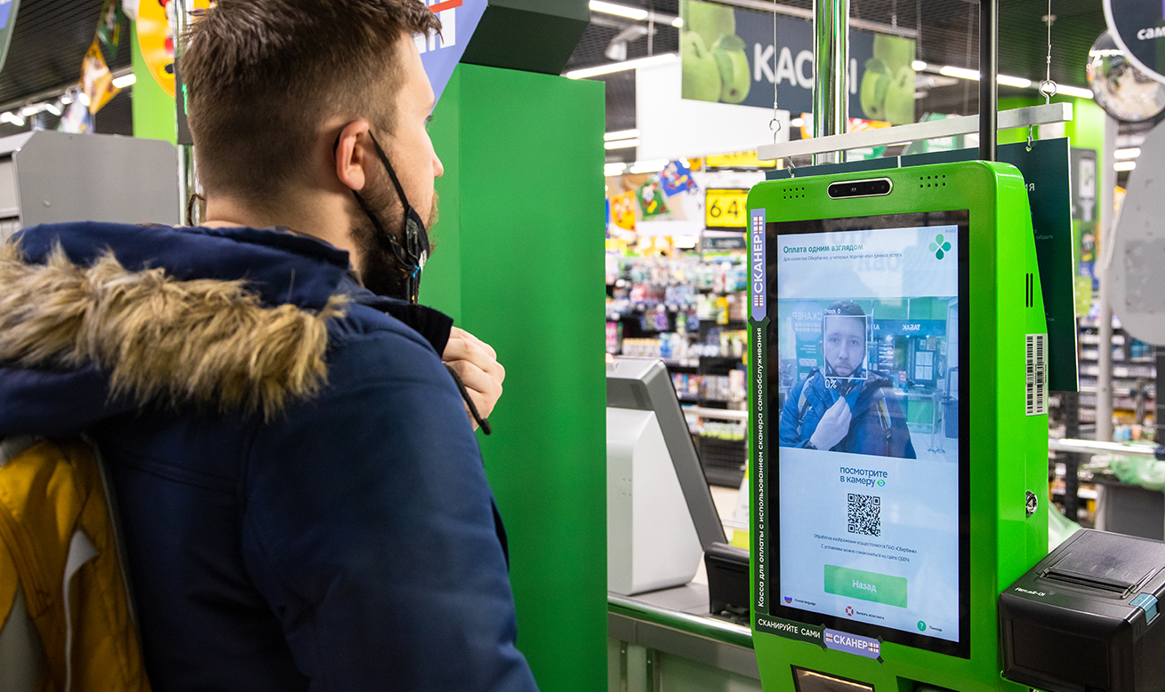
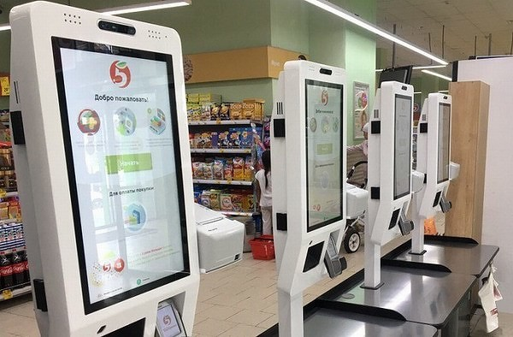
Retail: Perekrestok
Launched in test mode in 200 supermarkets
Launched in March 2021

Slide 25
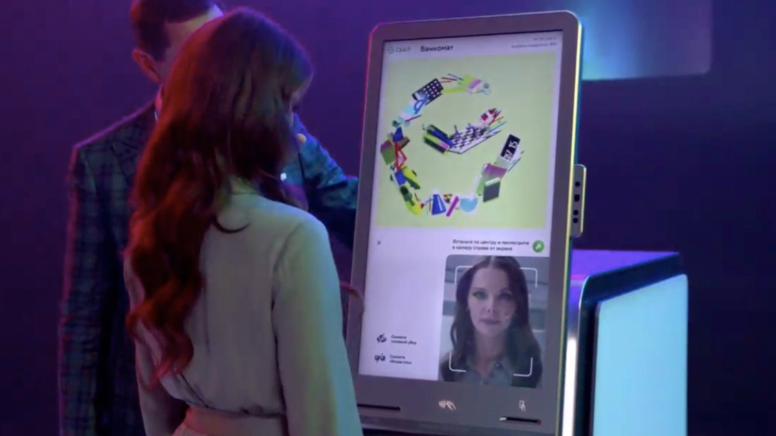
Bank: Sber
Whenever you call contact center: Voice confirmation
ATM: face id confirmation
On July 2021 42% АТМ supports identifying by face or 10% of whole ATM market

Slide 26
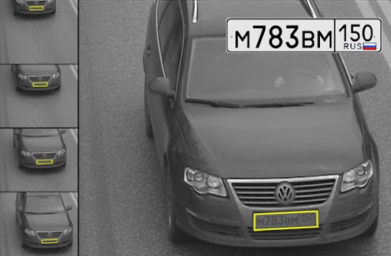
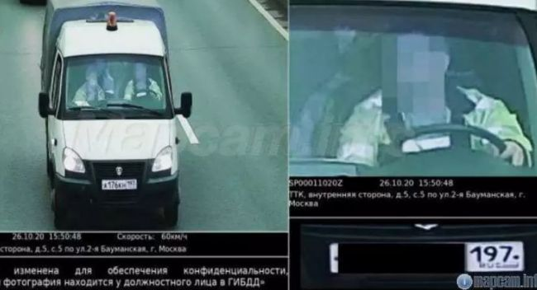
Transport
Plate numbers + automatic fines: works from Dec 2018
Fine for not using seat belt: July 2021: 62 cameras support it

Slide 27
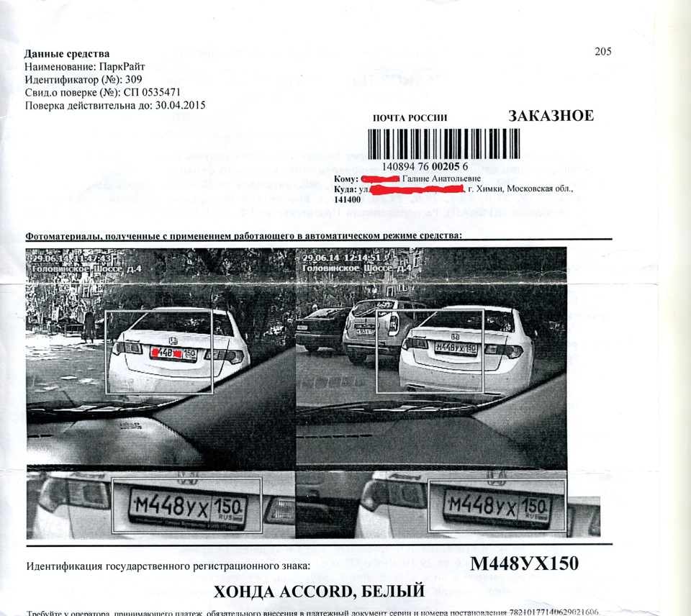
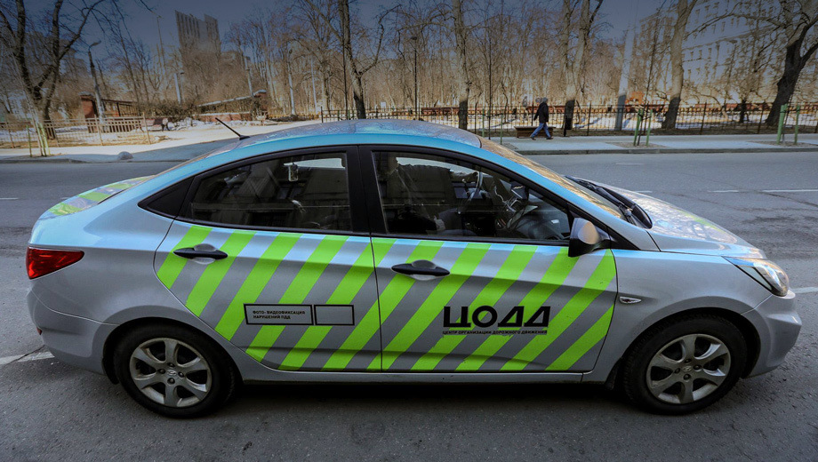
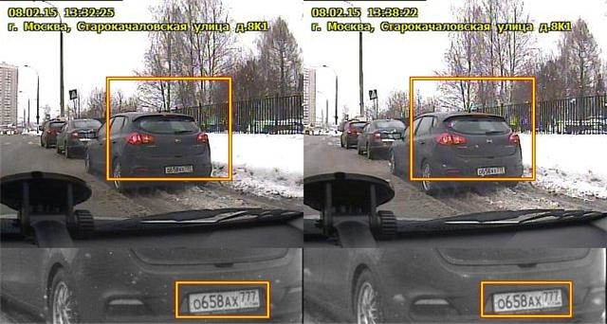
Transport: parking
Working from 2015

Slide 28
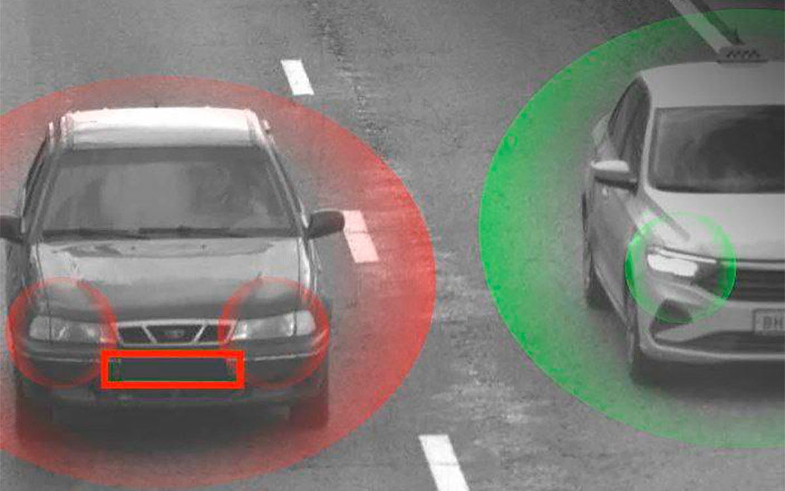
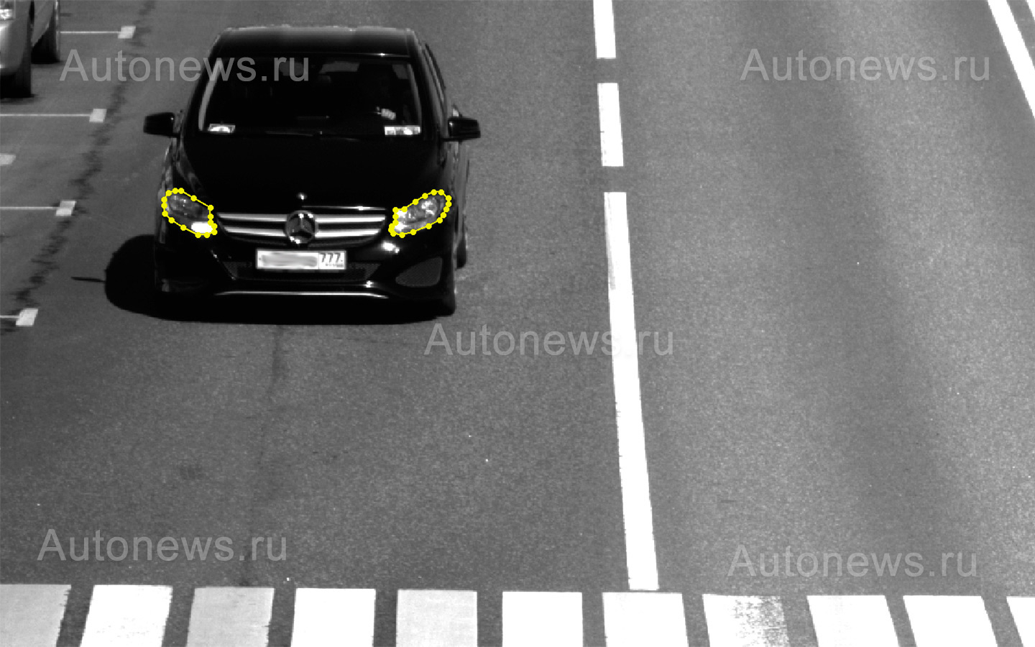
Transport
Identify turned off headlights: 17th October 2021: 1st camera enabled

Slide 29
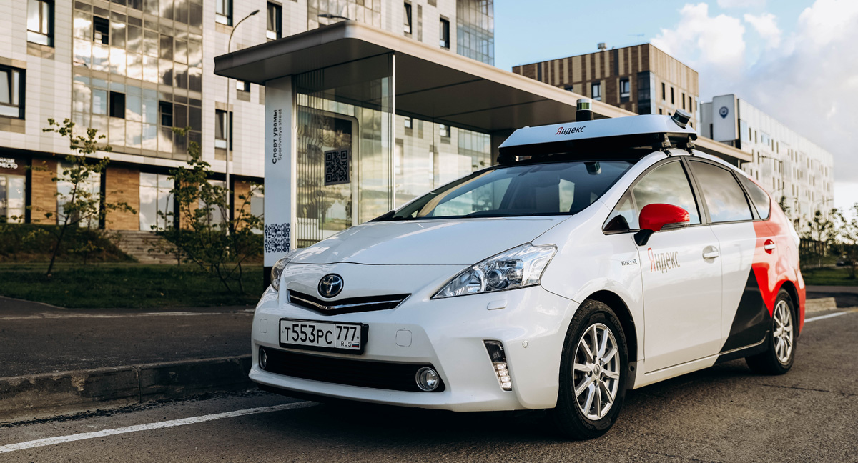
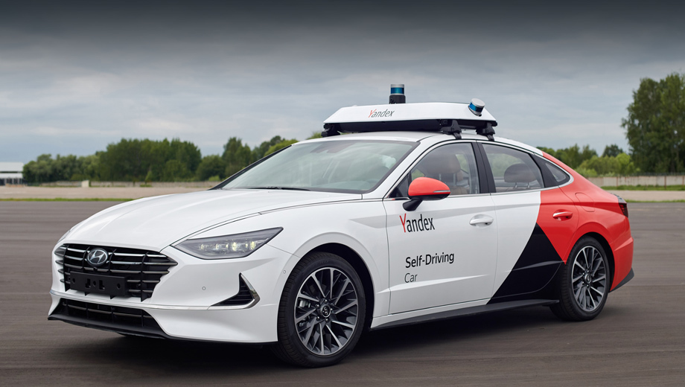
Transport: Self-driving cars

Slide 30
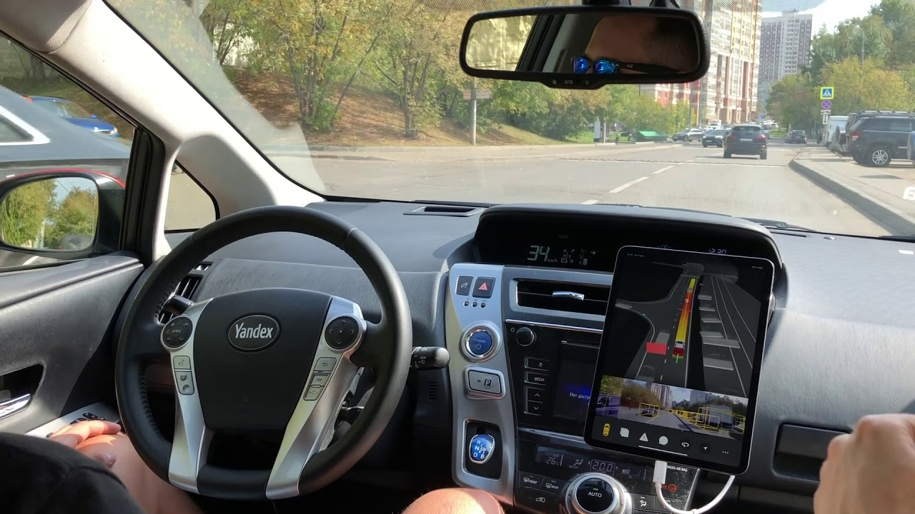
Self driving car inside

Slide 31
Self-driving cars: end-to-end approach
Neural Network
Classic approach: Lidars + cameras + radars

Slide 32
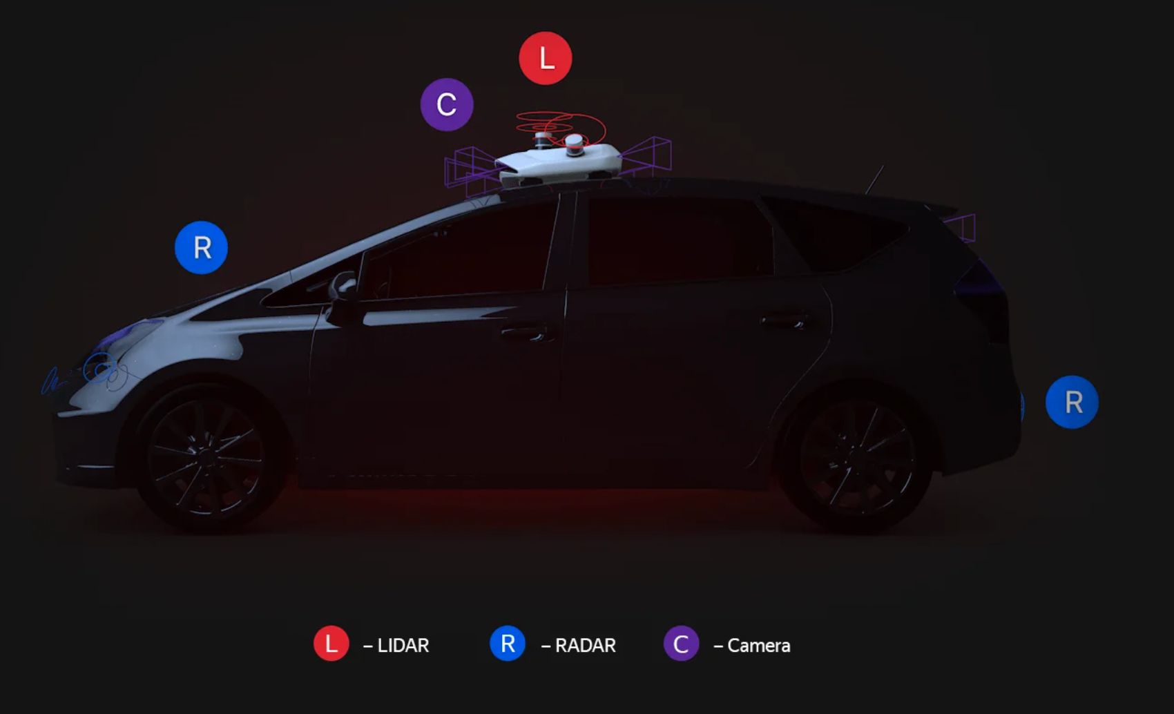
All sensors:

Slide 33
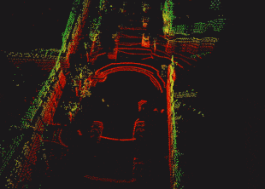
Lidar
Sends laser beams, receives it back
Based on time can calculate distance to the point

Slide 34
Lidar: advantages
Very accurate
High density of points
Works out of the box

Slide 35
Lidar: why can’t we just use it?
rough road
traffic fumes
Complete black car won’t be visible, because rays will be absorbed
We don’t separate objects by classes
Reflection from puddles
Weather: rain, snow
Price!!! >20k$

Slide 36
Camera:

Slide 37
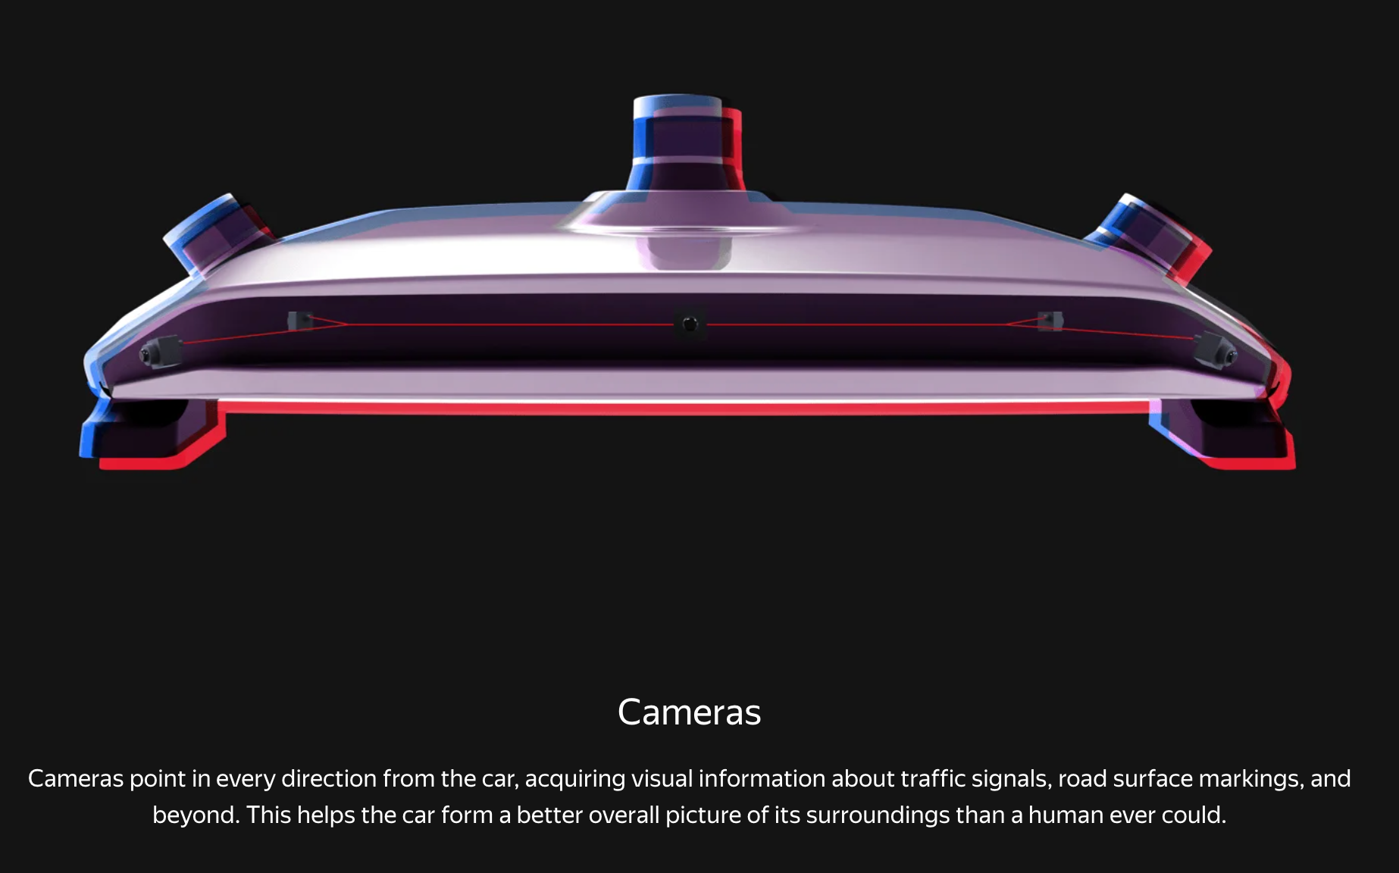

Slide 38
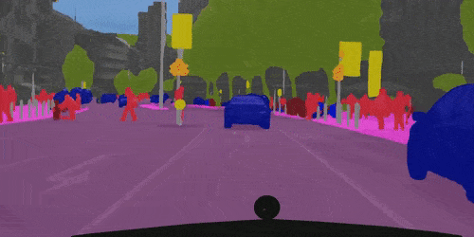
Camera: semantic segmentation

Slide 39
Radar:

Slide 40
Radar
RADAR works just like LiDAR, with the big difference that it uses radio waves instead of laser or light. It transmits radio waves from a rotating or stationary antenna and measures the flight time of the reflected signal.

Slide 41
Radar: advantages
Speed of objects
Diretions of objects
Work out of the box

Slide 42
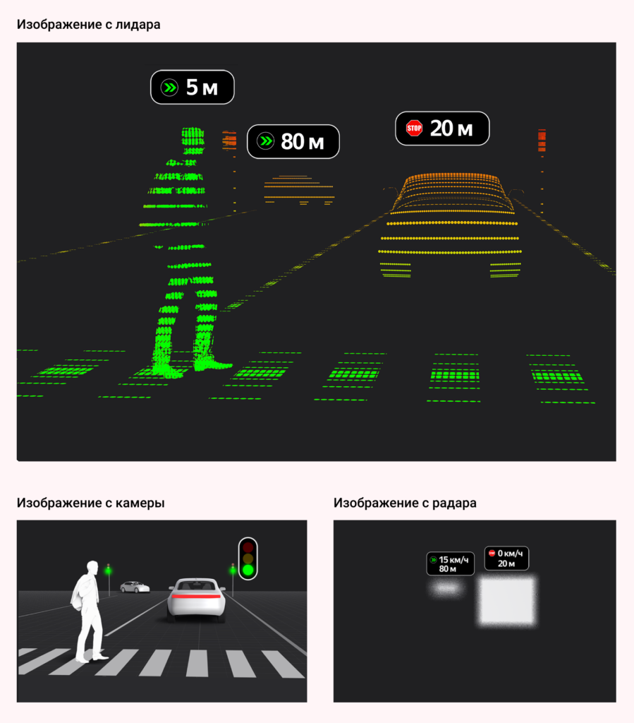
Lidar image
Camera image
Radar Image

Slide 43
Full scope
Localization
Detection
Planning
GNSS
Odometry
ICP
2D/3D objeccts
Semantic Segmentation
Trajectory
Traffic Rules

Slide 44
Full scope
Localization
Detection
Planning
GNSS
Odometry
ICP
2D/3D objeccts
Semantic Segmentation
Trajectory
Traffic Rules

Slide 45
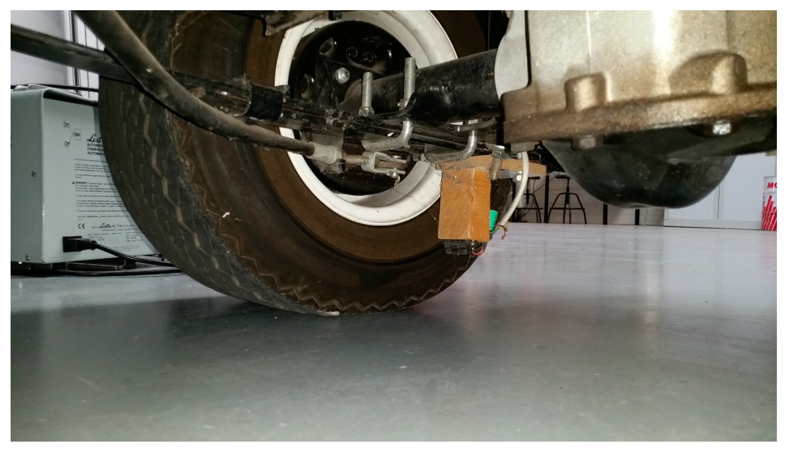
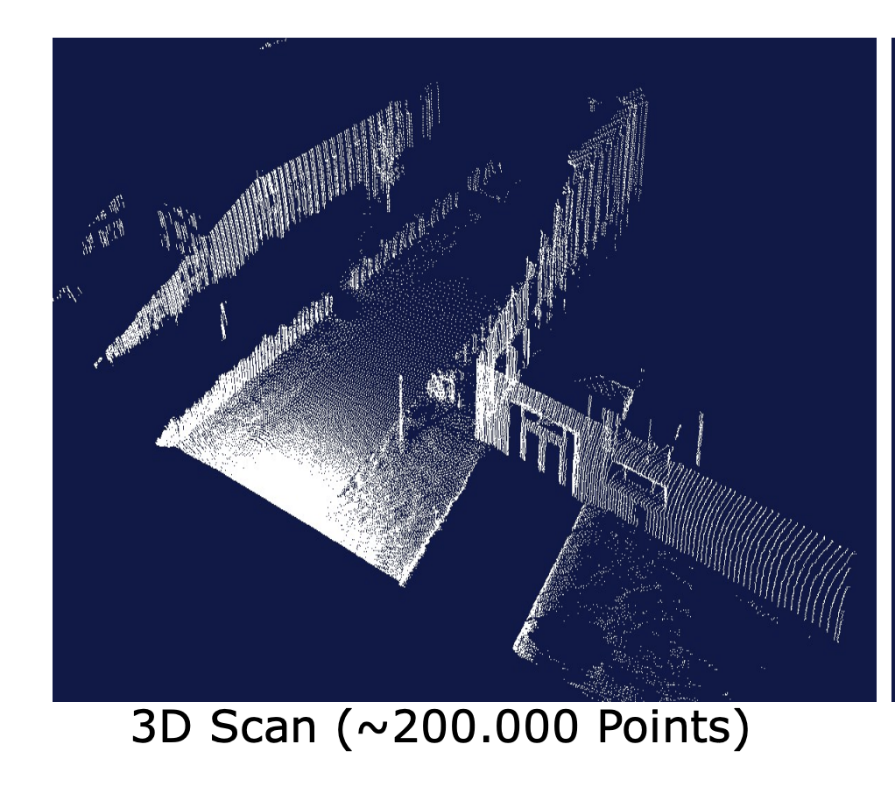
Localization
GPS: 5-10meters, in city 20m -> GNSS RTK (Real Time)
Odometry
ICP: iterative closest point

Slide 46
Full scope
Localization
Detection
Planning
GNSS
Odometry
ICP
2D/3D objeccts
Semantic Segmentation
Trajectory
Traffic Rules

Slide 47
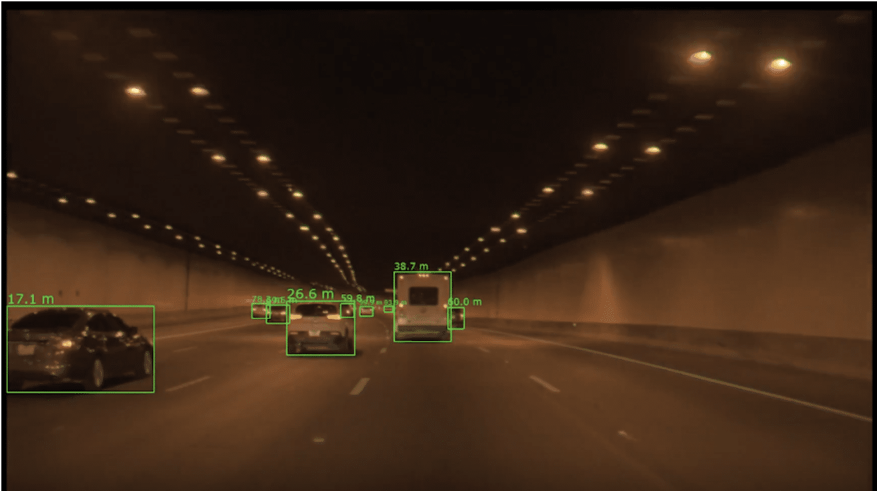
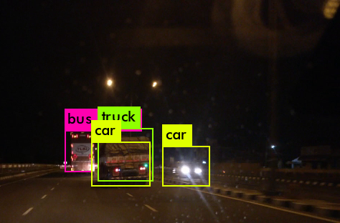
Detection: 2D objects

Slide 48
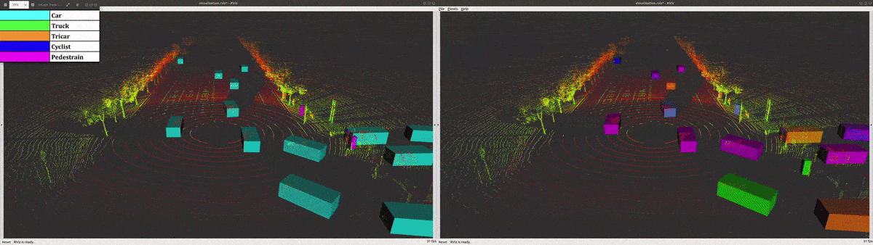
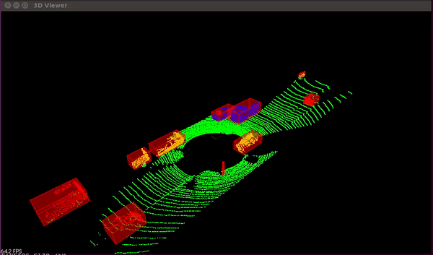
Detection: 3D objects

Slide 49
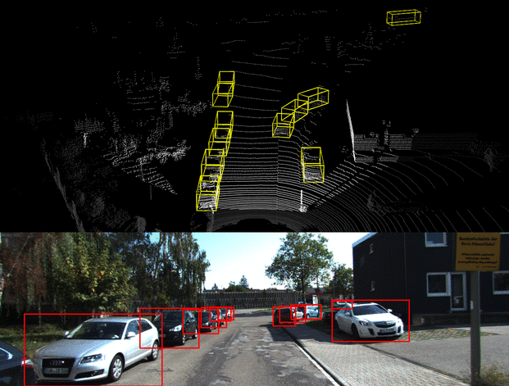
Detection: 2D and 3D together

Slide 50
Full scope
Localization
Detection
Planning
GNSS
Odometry
ICP
2D/3D objeccts
Semantic Segmentation
Trajectory
Traffic Rules

Slide 51
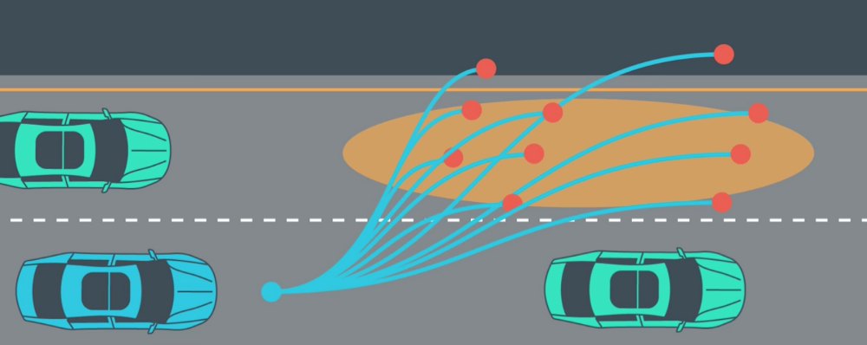
Planning
Traffic analysis
Should we give way for someone? Does traffic light allow to move? What is this pedestrian going to do?
Take decision
Change the line/wait until pedestrian will cross the road/slow down/go into parking mode/…
Build trajectory
Build possible trajectories and choose the best one
Complete trajectory
control

Slide 52
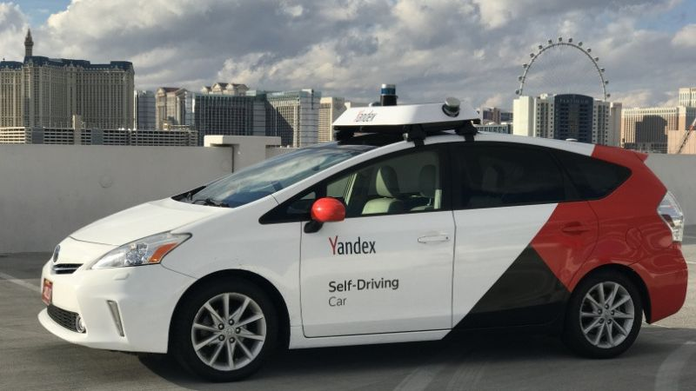
Self-driving Taxi:
2017: start of developing
2018: first inter-city trip in total 780km
2018: test mode for taxi in one of Russian cities
2018-2021 test mode on couple of regions in Russia (not taxi, just self driving)
Autumn 2021: for chosen customers taxi service will be available, around 170 cars in total

Slide 53
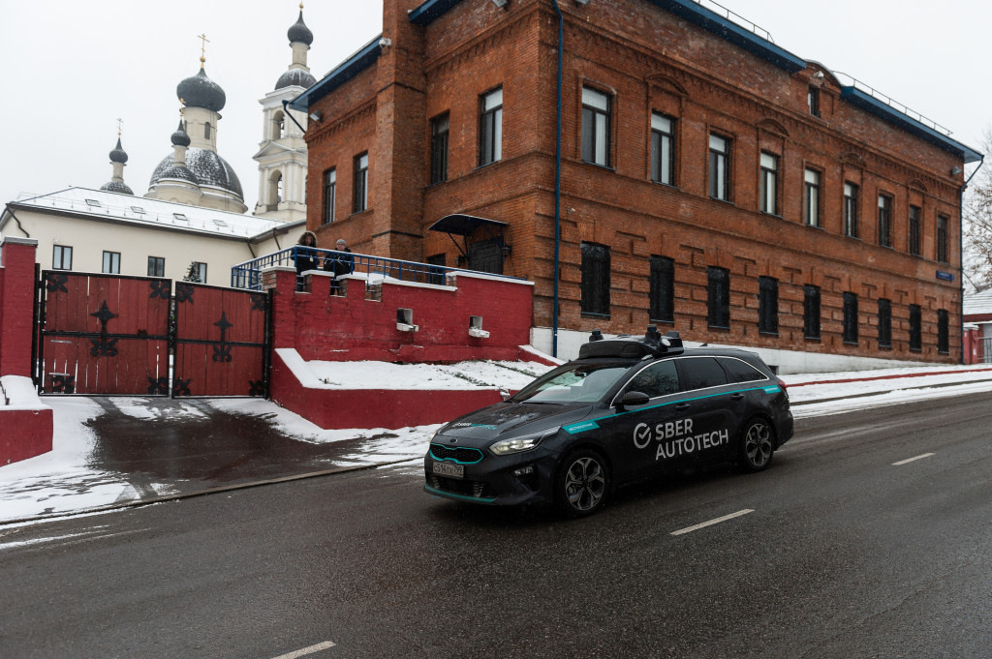
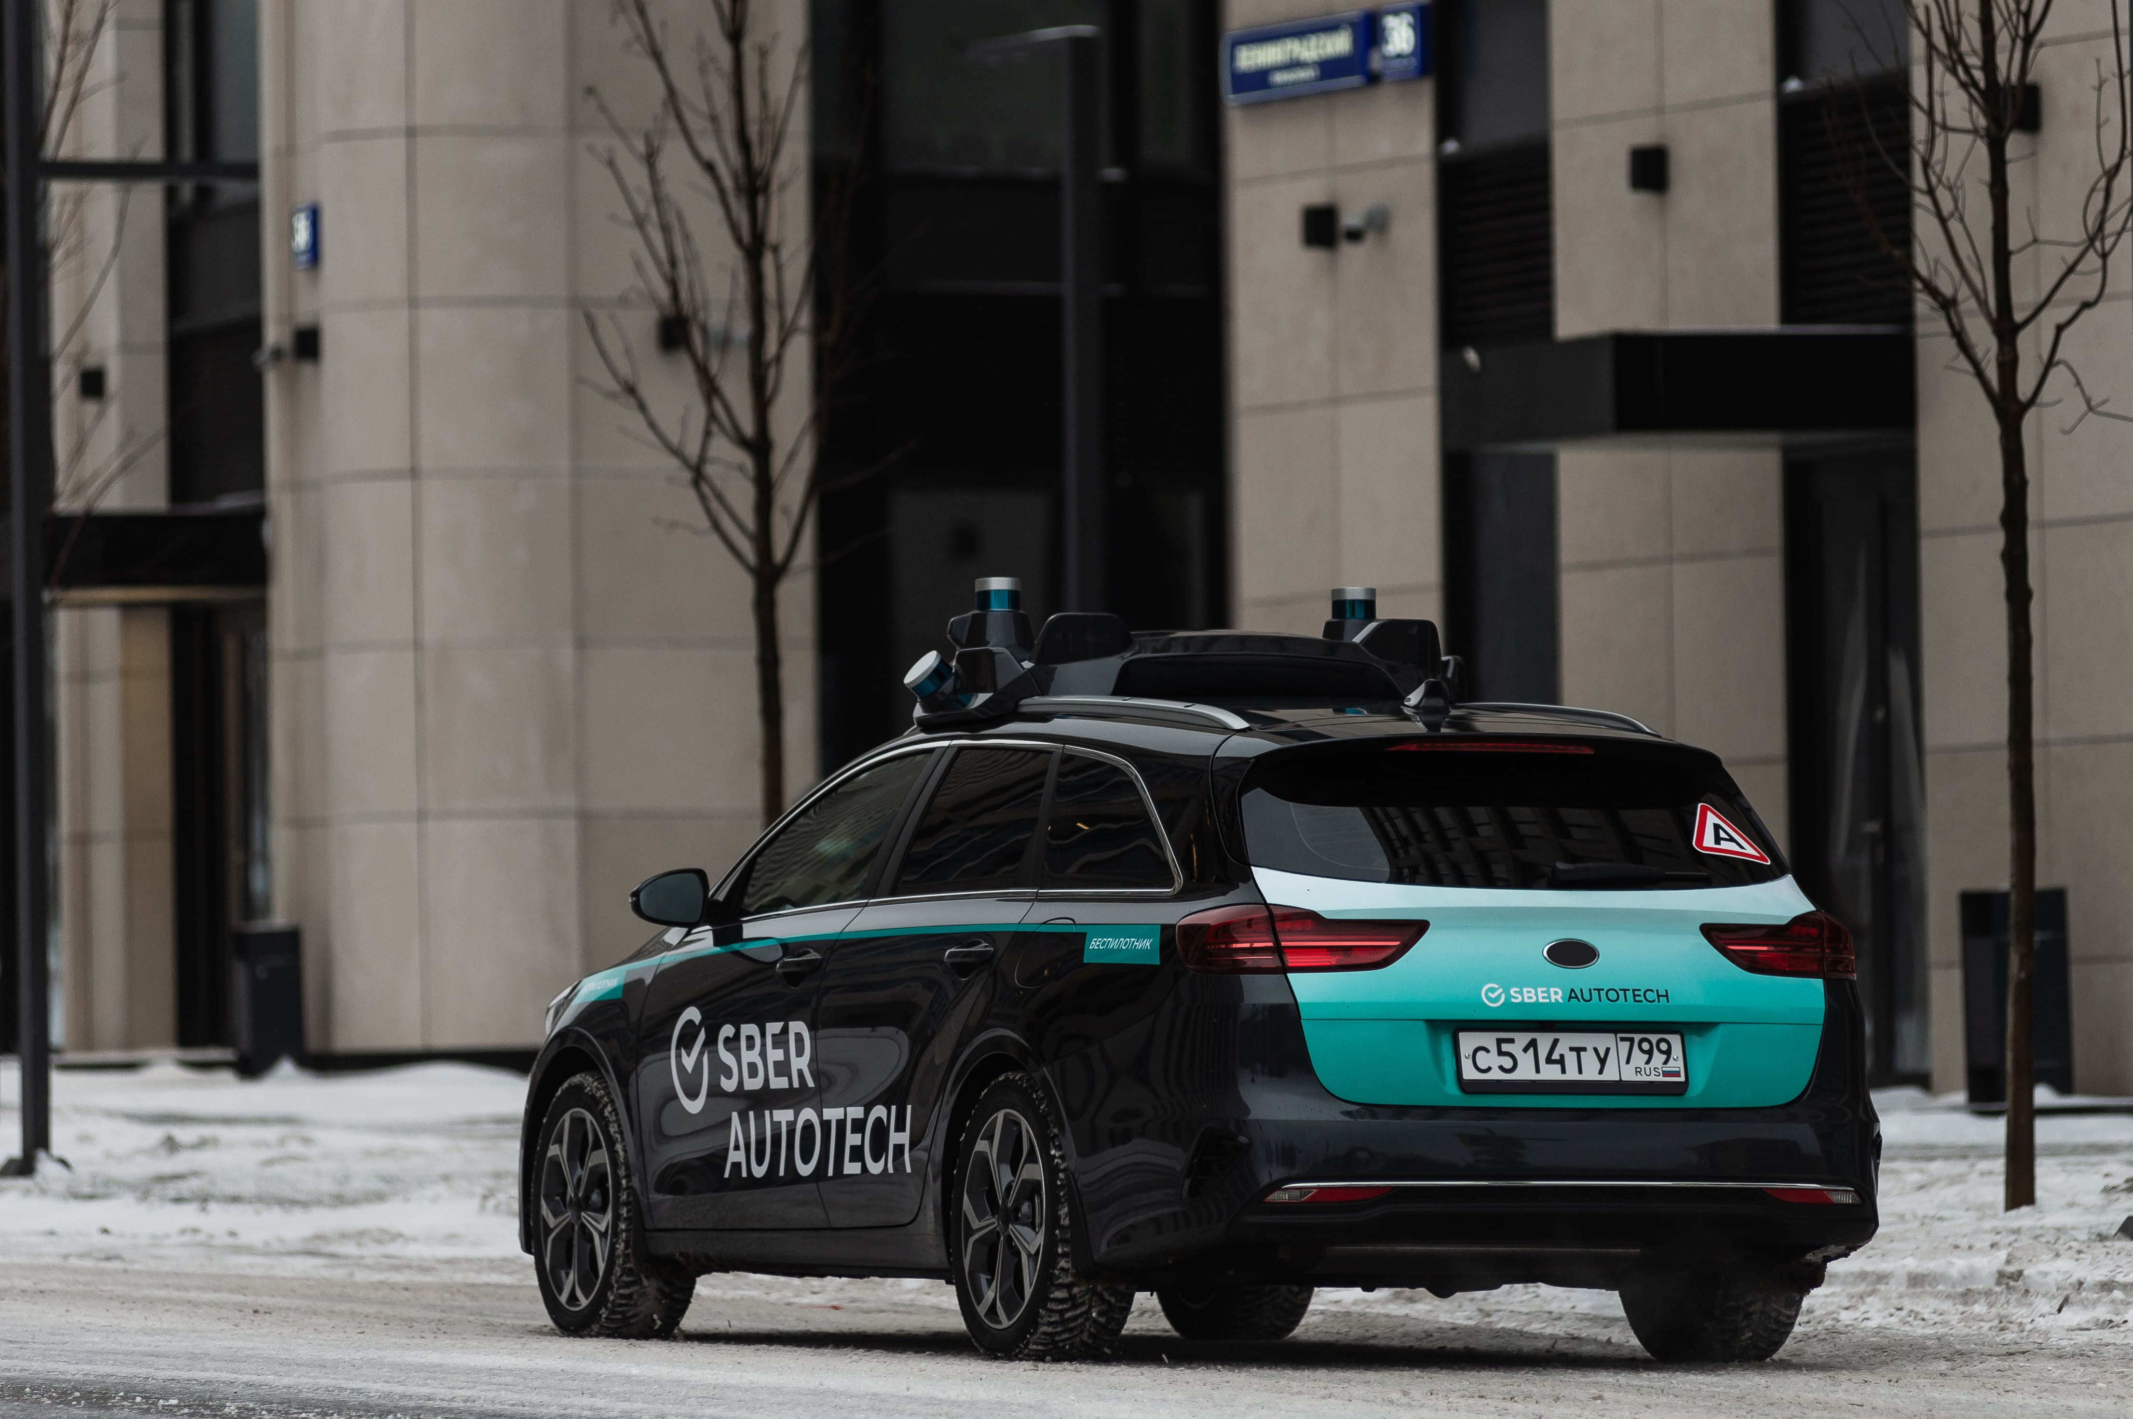
Self driving cars: more …

Slide 54

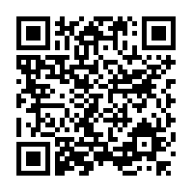
Thank you! Questions?
Presentation: https://github.com/DmitriiDenisov/talks/blob/master/Hypermotion_3_Nov.pdf
LindedIn: https://www.linkedin.com/in/dmitry-denisov-022102103/
Web: https://ddenisov.com/

